Slide 1
Interests profile

Slide 2
Unifrog Interests profile – what is it?
This tool has been created based on Holland’s theory. It is of the idea that the careers you are likely to enjoy are linked to your personality. John Holland identified six categories of personality and the careers associated with them. No one’s personality fits neatly into just one category, but by finding which of the categories you are closest to, you will see the list of professions which correspond best to you.
Based on the results upon completing the Interests profile quiz, you will be able to explore careers and subjects best suited with your personality and even those that you may not have thought of otherwise!

Slide 3
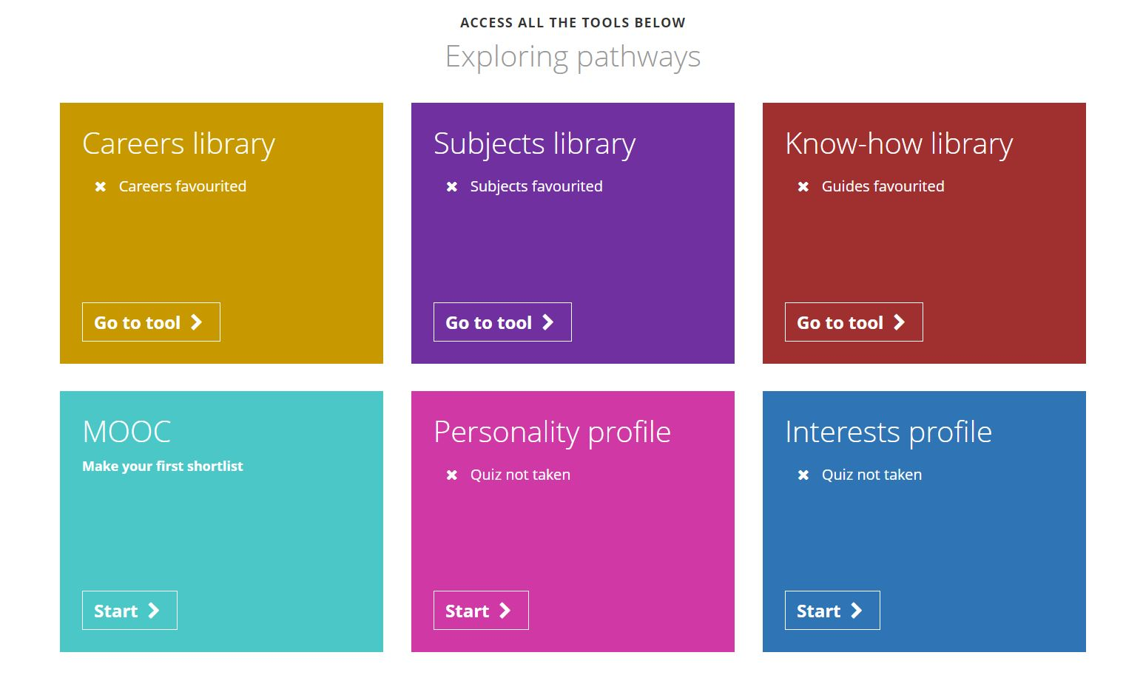
To get started, go to the student side of the platform at unifrog.org/student/home and click ‘Start’ on the Interests profile.

Slide 4
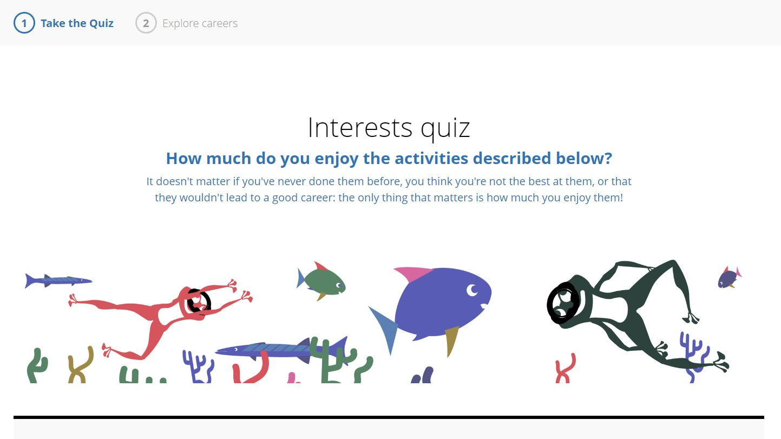
You will be asked to answer a range of different questions. You can select whether you agree, disagree, or sit somewhere between those two points.

Slide 5
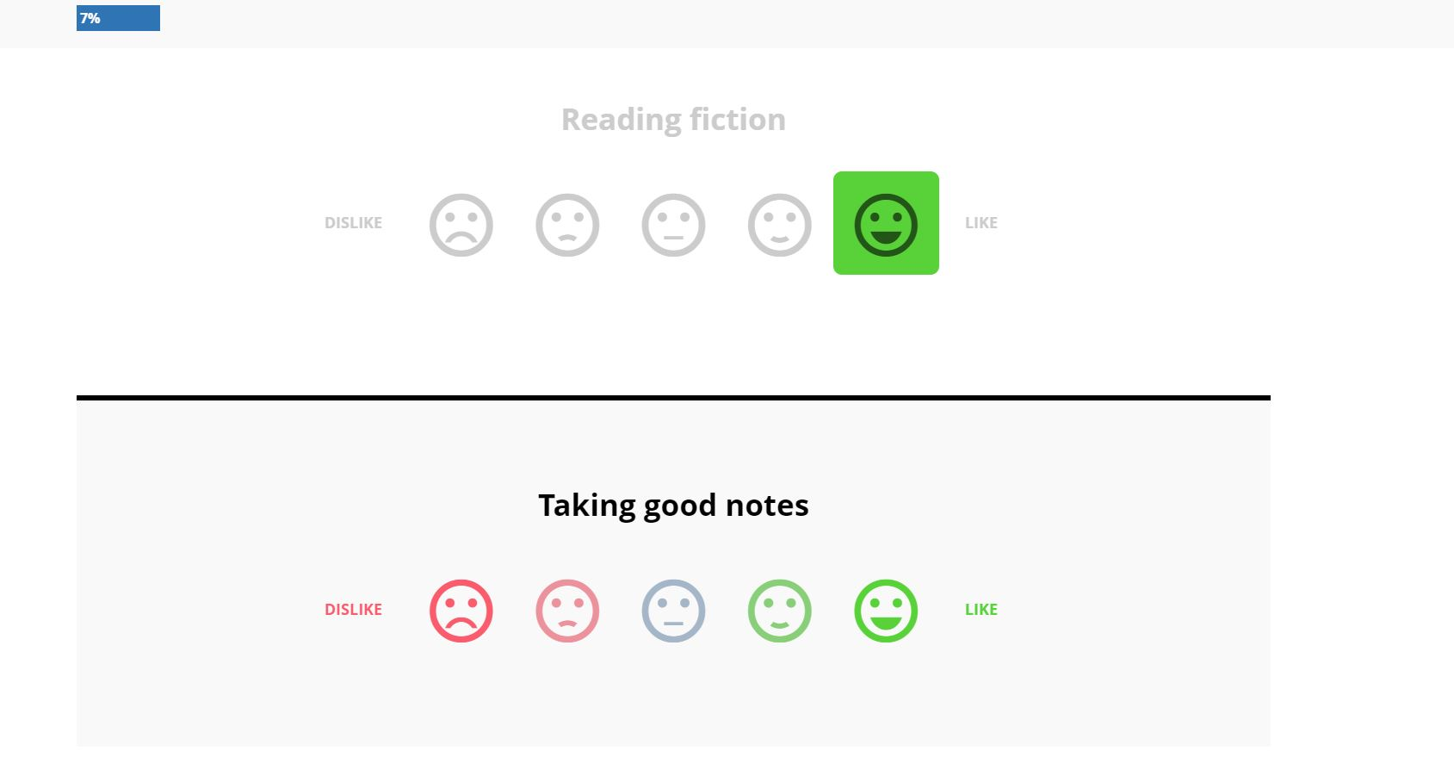
The blue progress bar at the top left hand side will increase as you answer the questions. The bar will continue to increase until you have finished the quiz and reached 100%.

Slide 6
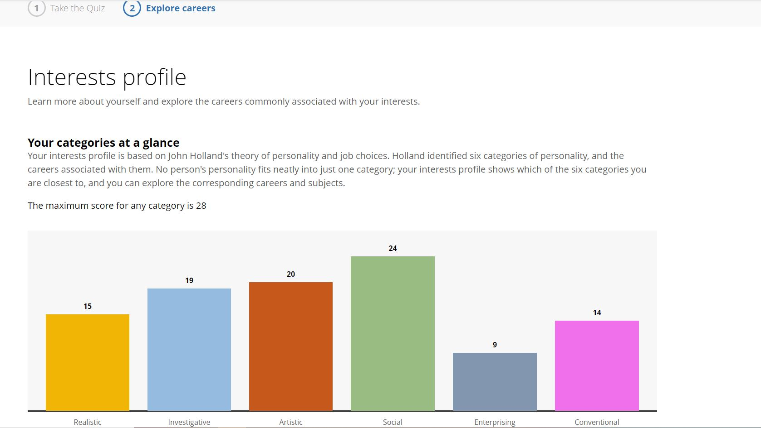
Once you have answered the questions, click ‘Get your results’. Here, your personality will be broken down into 6 categories and where you sit within each of them, based on your interests!

Slide 7
Your categories will appear in order from highest to lowest, where you will be able to expand each to read more about the specified category.

Slide 8
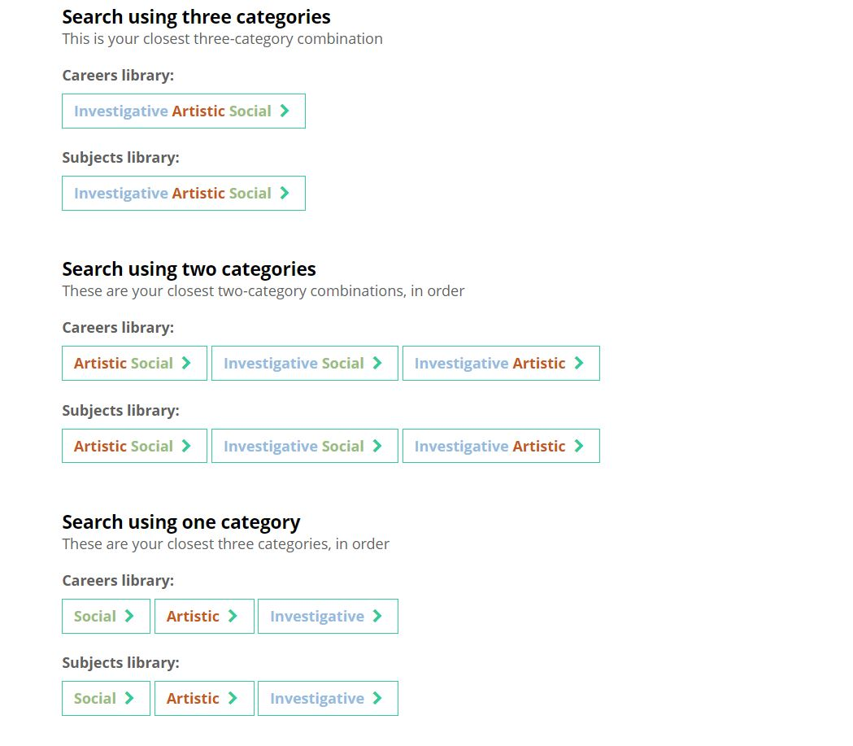
Using category combinations, you can search for careers and subjects that might be suited to you from the Careers and Subjects libraries.

Slide 9
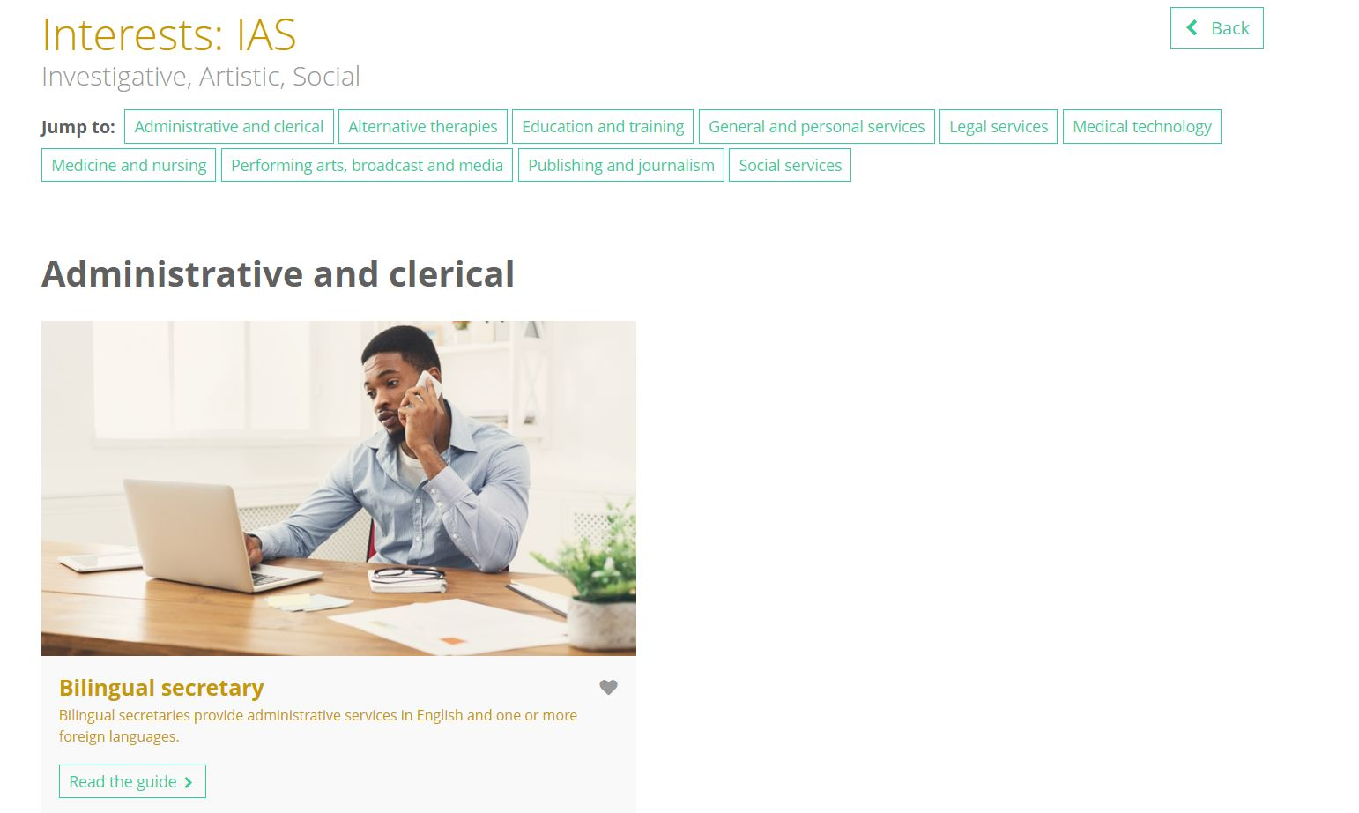
These links will take you directly to the Careers or Subjects library where you can find detailed information on these matched profiles.

Slide 10
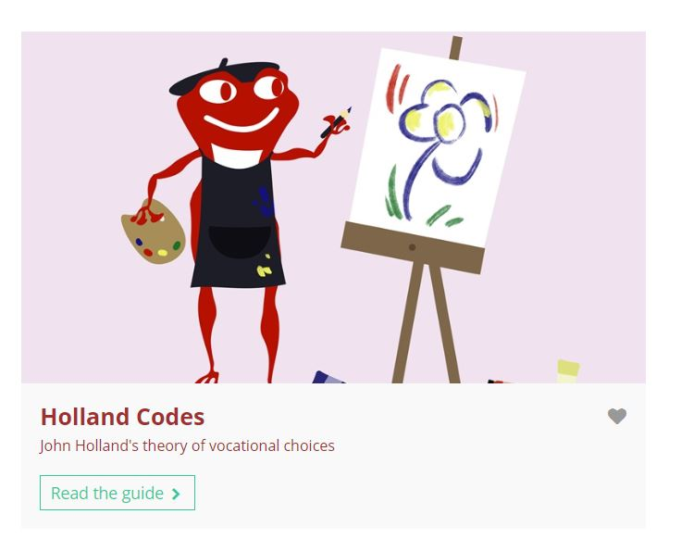
If you would like to find out some information about the theory behind the Interests quiz, you can click the ‘Know-how library’ link which will take you directly to the guide homepage. Here, you are able to read the article explaining the background behind the Holland theory!

Slide 11
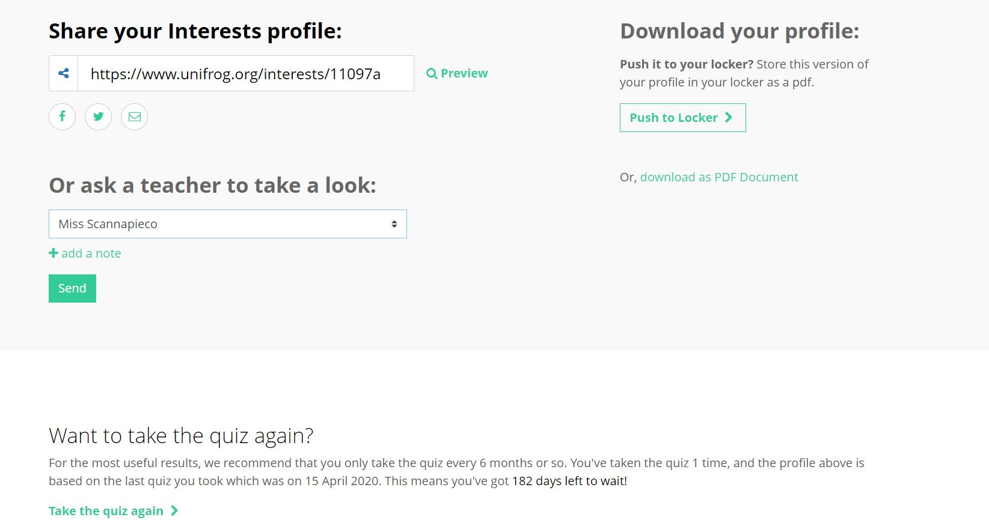
Your Interests profile can be saved as a PDF to be pushed to your Locker, or sent to a teacher.
The quiz can be done as many times as you wish, just follow the link at the bottom of the page!

Slide 12
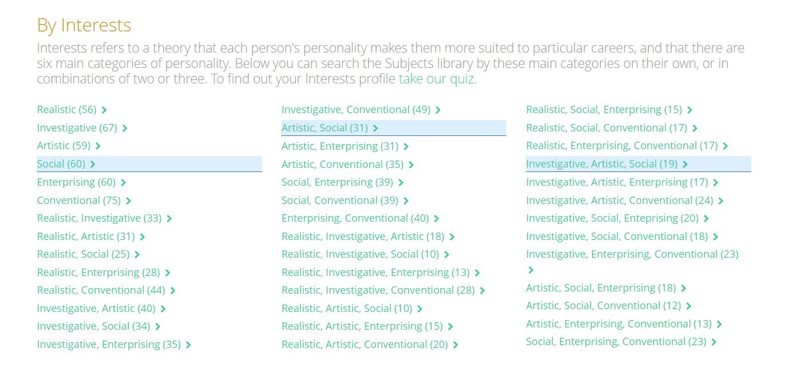
Once you have completed the Interests quiz your personality categories will be highlighted in the Careers and Subject libraries.
Here you can find out some more information about the careers/subjects most commonly associated with your personality!

