Slide 1
Subjects library

Slide 2
The Benefits
Comprehensive research
An extensive, searchable database featuring detailed profiles of every major university subject area.
Smart search options
Explore subject areas by keyword, personal interests, typical course characteristics or your favourite subjects at school!
Unique insights
‘In-depth’ sections cover a reading list, podcasts to follow, films to watch, articles to read, and hot topics to think about.

Slide 3
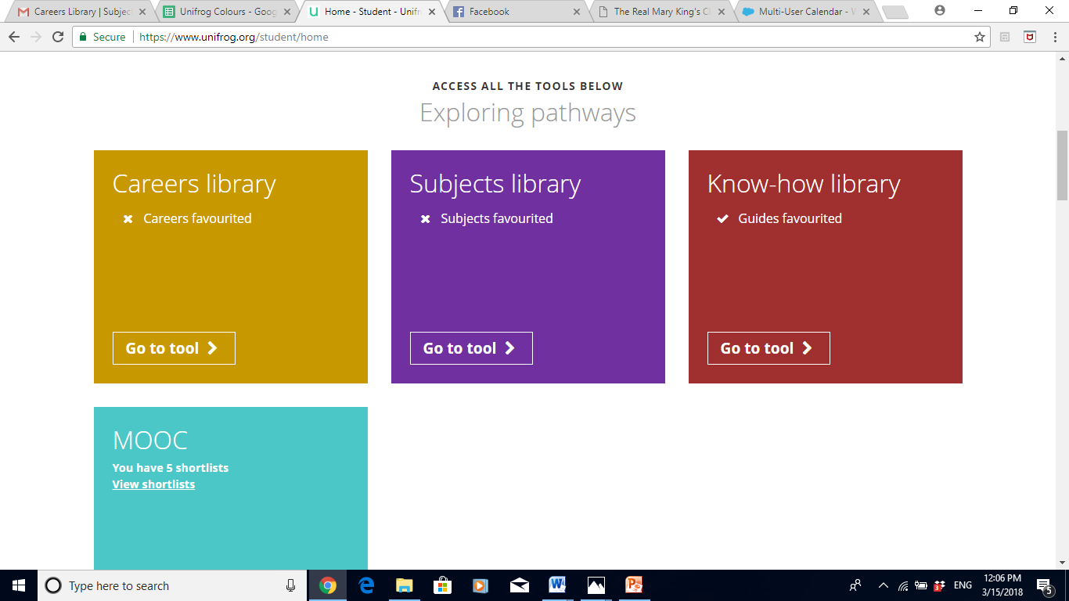
From the student dashboard at unifrog.org/student/home, click ‘Go to tool’ on the Subjects library box.

Slide 4
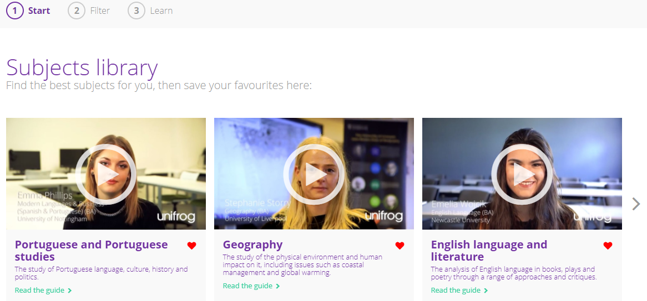
More than 100 subject profiles are featured in the subjects library! You can store your favourites at the top of the library for easy access.

Slide 5
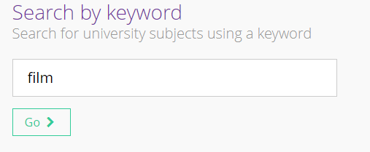
Use the smart searching options on the library homepage to access and explore different subject profiles suited to your particular needs and interests.
First of all you can search by a keyword using the text box provided.

Slide 6
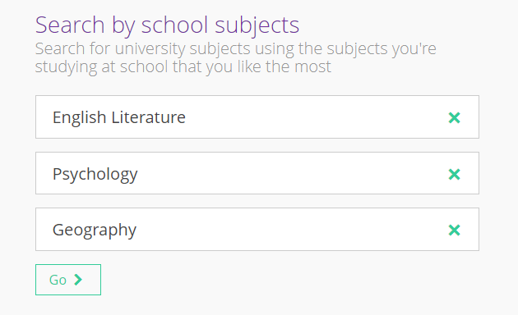
You can also search by your favourite subjects you take at school. This will show you university subjects which students who did the same subjects at school as you went on to do at university.

Slide 7
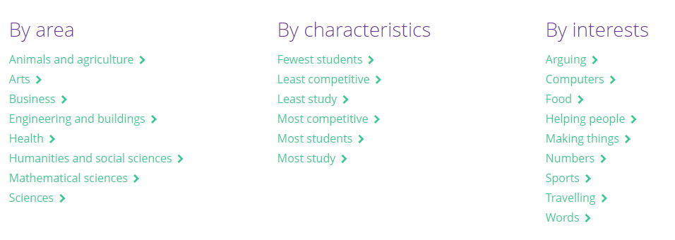
You also have the option to search by a particular area you are interested in.
E.g. ‘Arts’, a characteristic of the course such as ‘Least students’, or something which interests you such as ‘Food’.

Slide 8
Searching by keyword, characteristic or interest will show you different subject areas that are relevant to you.
You can jump between subject areas using the buttons at the top of the screen.
Specific university subjects will feature underneath each subject area.

Slide 9
Searching by subject area will show you university subjects which typically lead to a high paid, medium paid or low paid job role.

Slide 10
Searching by school subjects will return university courses which are either a ‘close match’, a ‘medium match’ or a ‘tenuous match’ to your search.
This is based on how many of your subjects are in the top 10 most popular subjects taken by students actually doing that course.
Click ‘Read the guide’ to find out more information.

Slide 11
Each profile provides impartial information about the subject such as what you’ll be learning and the modules which might be available to you.
Make sure you scroll further down the page to find out about future career prospects and salary potential, as well as some cool courses within that subject area.

Slide 12
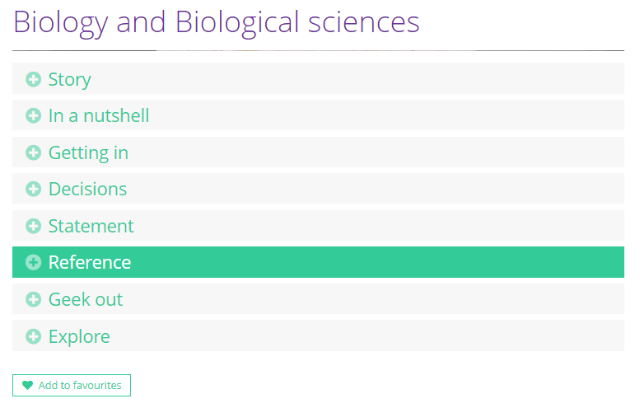
You can favourite any guides which you find interesting and wish to refer back to by clicking on ‘Add to favourites’ at the bottom of the profile.

Slide 13
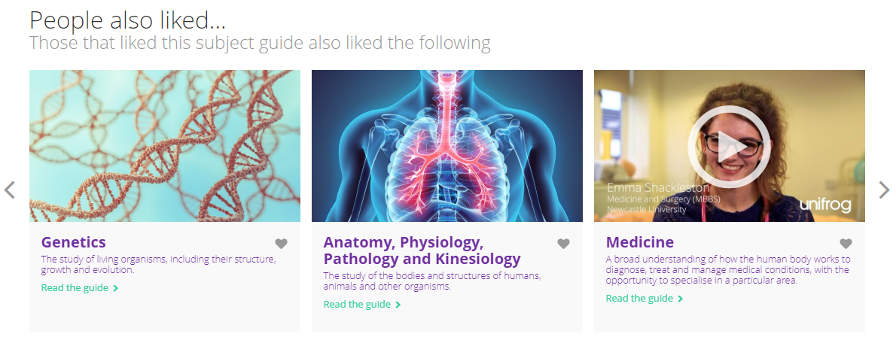
At the bottom of the page you can see subject guides that other students have also favourited.

