Slide 1
Apprenticeships

Slide 2
Post 16 & Post 18
It’s easy to consider Sixth Forms, colleges, universities as Post 16 and Post 18 options – these are the most popular pathways.
… But are they right for you?
… What about other pathways, like APPRENTICESHIPS?

Slide 3
Did you know…?

Slide 4
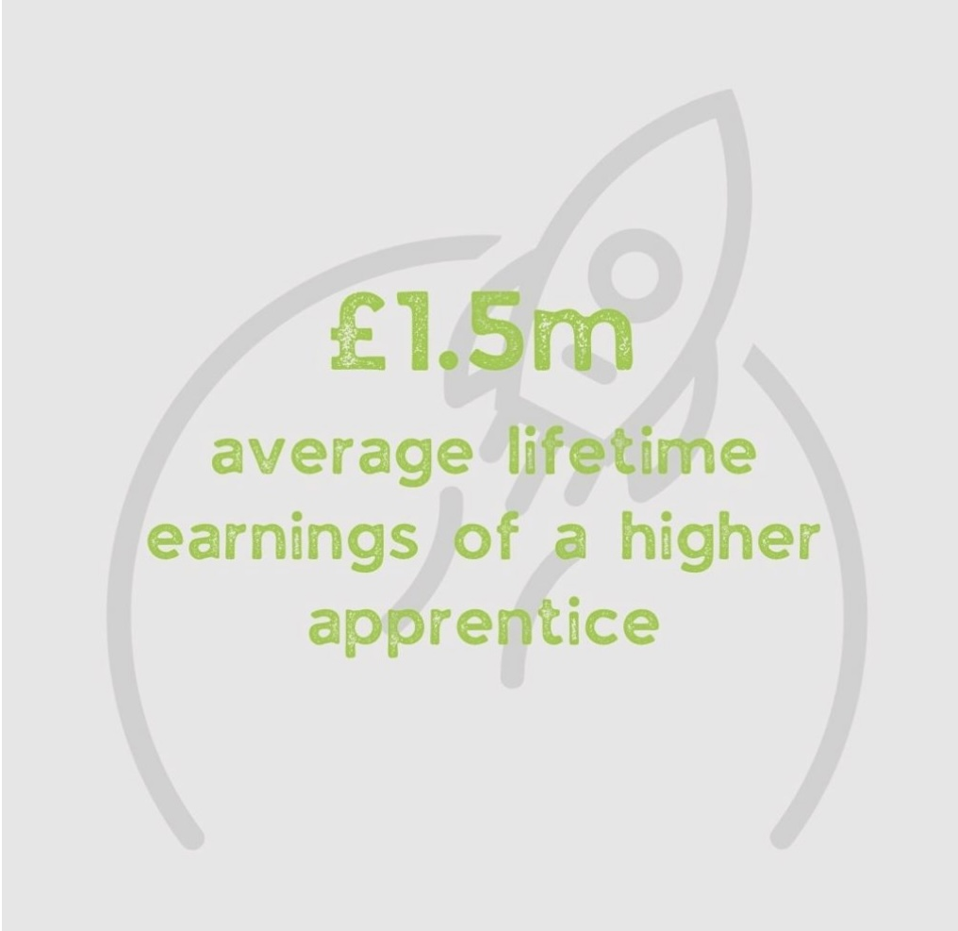
How much do you know about apprenticeships?
1
3
2
4

Slide 5
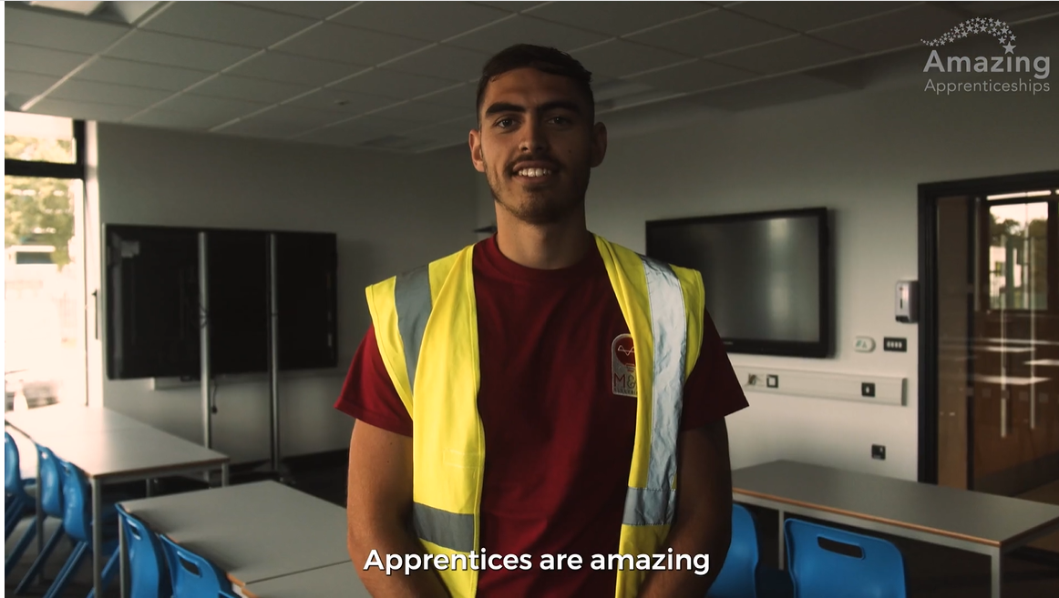
Click the image to play

