Slide 1
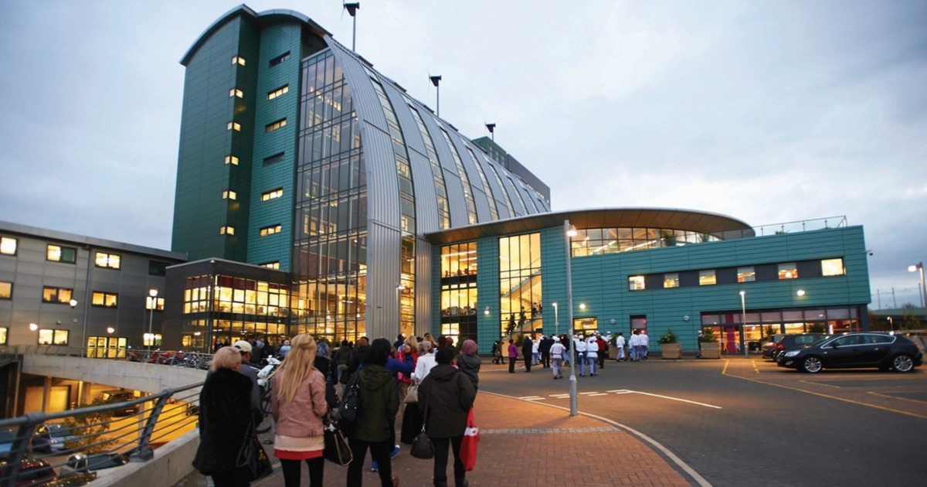
What do I want to do after Y11?
What are my choices?
College
6th Form
Apprenticeship
Notes:
3 different choices
Apprenticeship paid, college and 6th form not
Three different levels of study available, classified as Level 1, 2 or 3.
L1 (similar to GCSEs grade 4/5)
L2 (above a 5)
L3 (A Levels or equivalent standard)

Slide 2
But I’m only in Y10 – why so early?
June - writing a personal statement for your application for courses in Y11
November – Sheffield Progress applications open, this is the post-16 application portal for all post-16 apprenticeships and study in Sheffield
School deadline for applications January 14th 2022
Don’t need to know all the answers now but you need to start thinking now
Notes:
Everything you do post 16 you have to formally apply for. Formal applications start at the beginning of December, so it’s really important we start to think about the options available now.

Slide 3
How can I find out about careers?
Career of the Week
Teachers sharing their subject pathways
Ask your teacher/school adults/families about their previous jobs
Careers Week in May
Visitors to school
Careers Guidance Interview – now started for Y10s
Notes:
We’re talking more about careers as a school now, and trying to show the relevance across all subjects.
In May we’re having a careers week, so in every subject there will be at least one lesson with a focus on where that subject pathway can take you

Slide 4
What websites are available to help me?
Unifrog https://www.unifrog.org/
iCould https://icould.com/
BBC Bitesize careers https://www.bbc.co.uk/bitesize/careers
https://www.ucas.com/ucas/after-gcses/find-career-ideas/explore-jobs - careers info/options with your subject
https://www.ucas.com/careers/buzz-quiz - careers matching quiz
Sheffield Progress https://www.sheffieldprogress.co.uk/courses/
Notes:
After Easter, Ruth, our careers adviser, will explain what happens in a careers guidance interview
Careers interviews have already started now for Y10s – the more research and thinking about your future you can do before your interview, the more useful you will find it.
Here are some suggested places to start. We will put this presentation onto the careers section of the website and share it with you and your parents via email. These are really good places to start looking for future careers ideas.

Slide 5
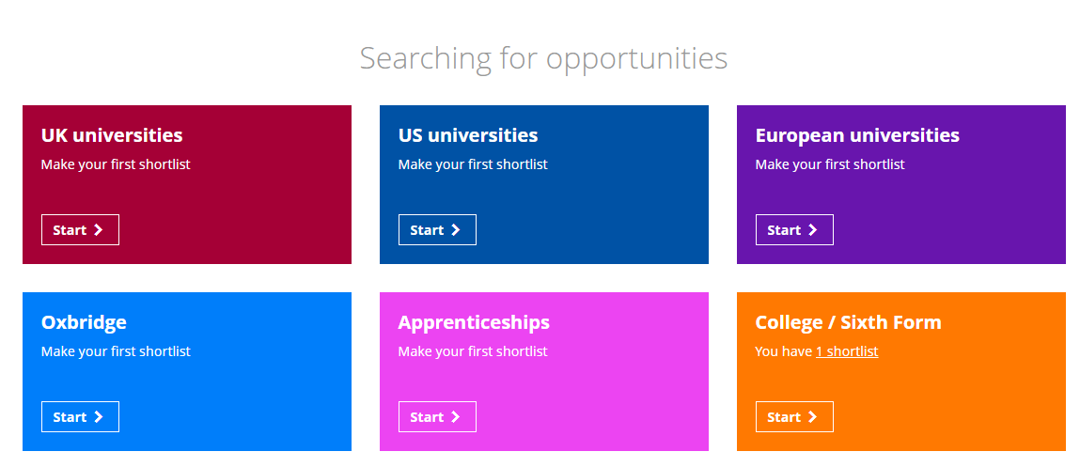
Unifrog
Explore these two areas, you can then save courses into your Unifrog locker. This is still being updated, so for a more accurate search, double check on Sheffield Progress too.
Notes:
Be aware that although Unifrog’s careers library is great, the college/6th form option has lots of courses information, but it isn’t up to date yet with local places that offer those courses. It’s still anew platform so not everything is quite ‘there’ yet.
Use this for information about courses, but for where you can study, use Sheffield Progress on the following slide.

Slide 6
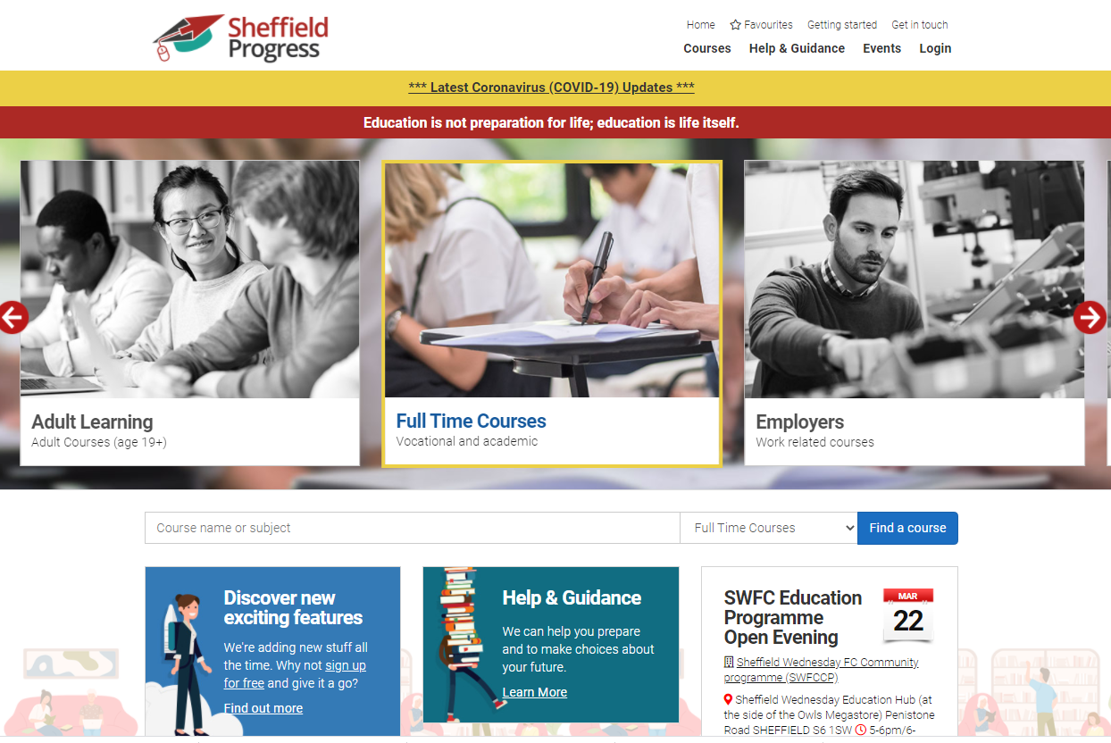
Sheffield Progress
Click in the relevant box to explore…
Or search for a specific subject or course
Notes:
This is the platform through which you apply for all your post-16 options. At the end of November you will be given a password so you can start your applications, but you don’t need a log-on to access basic information about courses. Anyone can access this
Gives you info about courses, locations across the City etc.

Slide 7
I don’t know what I want to do… but I know what I DON’T want to do
Great – this is a starting point
Think about the skills you are good at and the subjects you enjoy – research those pathways

Slide 8
What now?
Have a look at information from a variety of sources
Check out the careers section on the school website – this is being updated
Look at the websites with your parents
Mrs Johnson - Careers Leader
Ruth Mellors - Careers Adviser

